Slide 1
R Data structures

Slide 2
Topics covered
R data types
Data structures in R
Vectors
Matrices
Data frames
Lists
Factors
Importing data into R
Special programmatic elements

Slide 3
R Data types
revisiting

Slide 4
Data types
R needs to know what kind of data we are dealing with. And this in turn, dictates what functions and methods are available.
Numeric
Integer
Logical
Character

Slide 5
Numeric
Decimal values are called numerics in R
It is the default computational data type
If we assign a decimal value to a variable x
x will be of numeric type

Slide 6
Numeric
x <- 1234.11
class(x)
y <- 1234
class(y)

Slide 7
Integer
An integer is a whole number, but you cannot invoke it simply by assigning a whole number to a variable e.g. Y <- 1
is.integer(Y)
[1] False #it is considered a numeric
Instead we use the as.integer function e.g. y = as.integer(3)
class(y)
Can we assign a string variable e.g. “Wilson” as an integer? Running as.integer(“Wilson”) on the console

Slide 8
Logical
A logical value (True or False) is generated via comparisons between variables
> x = 1; y = 2 # sample values
> z = x > y # is x larger than y?
> z # print the logical value
[1] FALSE
> class(z) # print the class name of z
[1] "logical”

Slide 9
Logical
While on the topic of logical data type, we should also learn some logical operations
Standard logical operations are "&" (and), "|" (or), and "!" (negation).
> u = TRUE; v = FALSE
> u & v # u AND v
[1] FALSE
> u | v # u OR v
[1] TRUE
> !u # negation of u
[1] FALSE
To find out more use the help function e.g. > help("&")

Slide 10
Character
Character object is use to store string values in R e.g. “Apple”.
It can also be used to convert numeric objects into strings.
> x = as.character(3.14)
> x # print the character string
[1] "3.14"
> class(x) # print the class name of x
[1] "character"

Slide 11
Character
To extract a substring, we apply the substr() function
Here is an example showing how to extract the substring between the third and twelfth positions in a string
substr("Mary has a little lamb.", start=3, stop=12)

Slide 12
Character
To replace the first occurrence of the word "little" by another word "big" in the string,
we apply the sub function
sub("little", "big", "Mary has a little lamb.")

Slide 13
Data structures in R

Slide 14
Data structures in R
Data types can be assembled into larger and more complex entities called data structures
R offers a wide variety of data structures for satisfying different task requirements

Slide 15
Data structures in R
Factor
List
A
A
B
B
-a collection of entities with different lengths
multiple types
Multiple data structures (vectors, matrices and data frames)
-It is 1 column or row
-Contains “level” data which describes “levels” of classification e.g. class label A or B

Slide 16
Vectors
Vectors

Slide 17
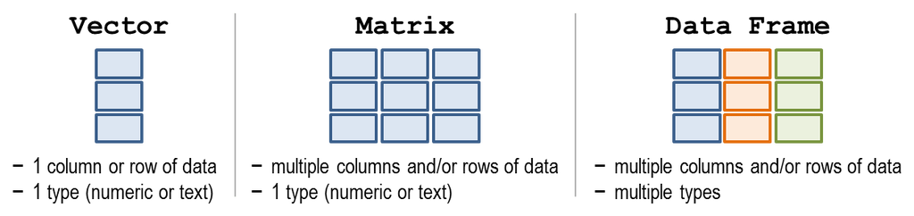
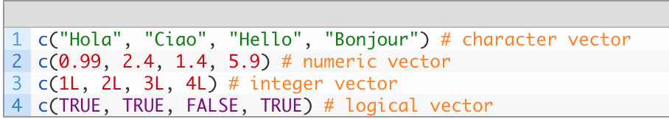
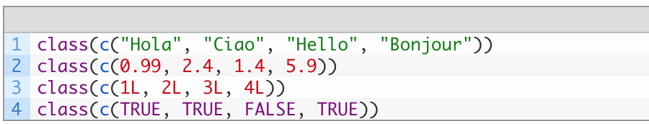
Vectors
A vector is a sequence of data elements of the same basic type. Members in a vector are officially called components or members.
Vectors may be created using the c() function
Check the data type using the class() function
Will return “character”, “numeric”, “integer” and “logical”

Slide 18
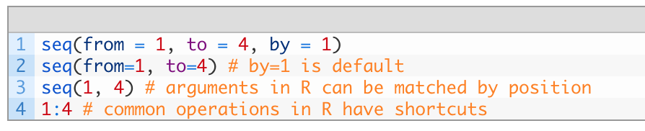
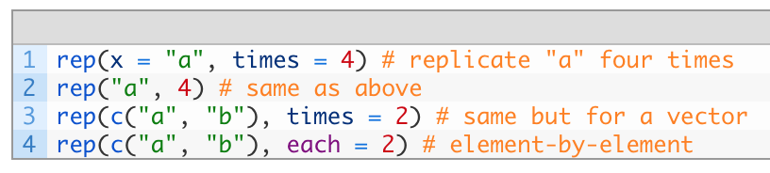
Vectors
Other ways of creating vectors
Using seq()
Using rep()

Slide 19
Vector index
We retrieve values in a vector by declaring an index inside a single square bracket "[]" operator.
S = c("aa", "bb", "cc", "dd", "ee")
aa
bb
cc
dd
ee
S =
The location of each element is marked by a position index.
Position
1 2 3 4 5
aa
bb
cc
dd
ee
S =
Position
1 2 3 4 5
aa
bb
cc
dd
ee
S[3] =
S[3] = c(“cc”)
Notes:
For example, the following shows how to retrieve a vector member. Since the vector index is 1-based, we use the index position 3 for retrieving the third member. (many programming languages start count at 0)

Slide 20
Negative vector index
If the index is negative, it would strip the member whose position has the same absolute value as the negative index.
Position
1 2 3 4 5
aa
bb
cc
dd
ee
S =
Position
1 2 3 4 5
X
aa
bb
cc
dd
ee
S[-3]=
S[-3]= c(“aa”, “bb”,”dd”,”ee”)
If an index is out-of-range, a missing value will be reported via the symbol NA e.g. S[10] will return NA

Slide 21
Vector slicing
A new vector, S, can be sliced from a given vector with a numeric index vector, which consists of member positions of the original vector to be retrieved.
Position
1 2 3 4 5
aa
bb
cc
dd
ee
S =
S = c("aa", "bb", "cc", "dd", "ee")
Position
1 2 3 4 5
aa
bb
cc
dd
ee
S[c(2, 3)] =
S[c(2, 3)] = c("bb", "cc")

Slide 22
Vector slicing
Or more simply, we can simply supply a range index e.g. S[Start:End]
Position
1 2 3 4 5
aa
bb
cc
dd
ee
S =
S = c("aa", "bb", "cc", "dd", "ee")
Position
1 2 3 4 5
aa
bb
cc
dd
ee
S[2:4] =
S[2:4] = c("bb", "cc”, “dd”)

Slide 23
Vector subsetting
Vectors can be subsetted by specifying a condition
Let’s create a vector with values from 1 to 5
S = 1:5
Position
1 2 3 4 5
1
2
3
4
5
S =
We now specify a condition on S
S[S < 3]
Position
1 2 3 4 5
1
2
3
4
5
S =
S[S < 3] = c(1,2)

Slide 24
Performing arithmetic on Vectors
Arithmetic operations of vectors are performed member-by-member
a = c(1, 3, 5, 7) b = c(1, 2, 4, 8)
Position
1 2 3 4
1
3
5
7
a =
1
2
4
8
b =
2
5
9
15
a + b =
5
15
25
35
a * 5 =
Notes:
Then, if we multiply a by 5, we would get a vector with each of its members multiplied by 5.

Slide 25
Named vectors
Members in a vector can have names. This is useful when you want to access a member by its name rather than by its position count.
V = c("Mary", "Sue")
Position
1 2
Mary
Sue
V =
We now name the first member as First, and the second as Last.
names(V) = c("First", "Last")
Position
1 2
Name
“First” “Last”
Mary
Sue
V =

Slide 26
Named vectors
names(V) = c("First", "Last")
Position
1 2
Name
“First” “Last”
Mary
Sue
V =
Instead of using numerical index, we can now retrieve the first member by its name
Position
1 2
Name
“First” “Last”
Mary
Sue
V["First"] =
V["First"] = “Mary”

Slide 27
Named vectors
we can even reverse the order of V with a character string index vector containing the names
V[c("Last", "First")]
names(V) = c("First", "Last")
Position
1 2
Name
“First” “Last”
Mary
Sue
V [c("Last", "First")] =
Sue
Mary
V [c("Last", "First")] =

Slide 28
Matrices

Slide 29
Matrices
A matrix is a collection of data elements arranged in a two-dimensional rectangular layout.

Slide 30
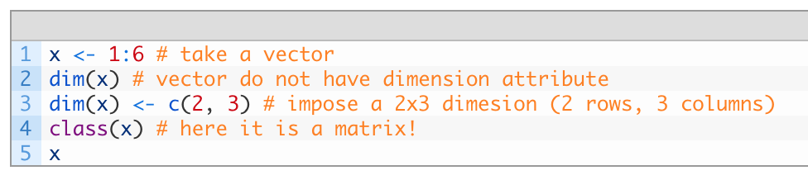
Building matrices
We reproduce a memory representation of the matrix in R with the matrix() function. The data elements must be of the same data type.
Several ways of using the matrix() function:
A not so common way
1
2
3
4
5
6
x =
1
3
5
x =
2
4
6

Slide 31
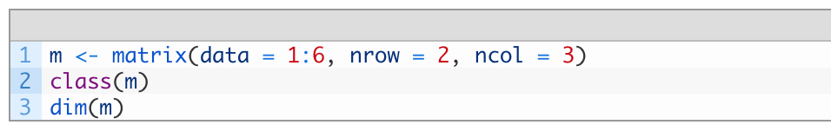
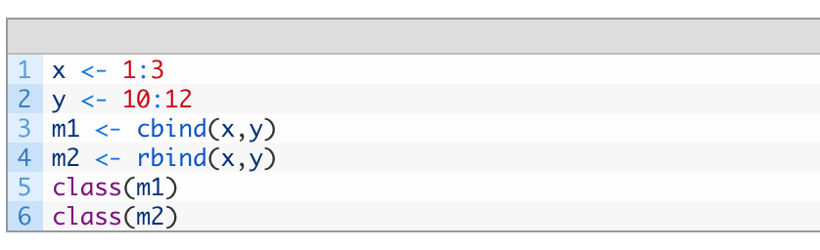
Matrix
The earlier expression can be made more elegant by writing it as one line
We can also combine 2 vectors of similar length using row bind (rbind) or column bind (cbind)
m1
m2
1
10
1
2
3
2
11
2 columns
3 rows
3 columns
2 rows
10
11
12
3
12

Slide 32
Accessing parts of matrices
You may access individual elements by A[x, y], where x is the row number and y is the column number.
1
2
3
1
2
3
A =
A[,1:3]=
10
11
12
10
11
12
3
10
11
12
A[2,] =
A[,3] =
12

Slide 33
Factors

Slide 34
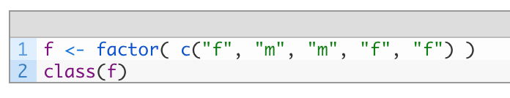
Factors
Factors are used to describe entities (samples) that can take on a class label (a category) e.g. disease or normal, rich or poor
Unlike vectors, factors can take on only a finite set of values (levels), as many categories as there are e.g. rich and poor (number of levels = 2); good, moderate, excellent (number of levels = 3)
Factors are initiated using the factor() function

Slide 35
Factors and levels
Factors have a levels attribute listing its unique categories
Access levels attribute with levels() function
In which case we will get "f” "m"

Slide 36
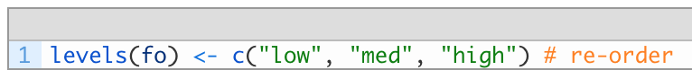
Changing level ordering
Consider the following factor, fo
Factor levels follow numerical or alphabetical ordering
So running levels(fo) will naturally return a vector as:
“high”, “low”, “med”, which doesn’t really make sense to us!
We can fix this by specifying the order ourselves

Slide 37
Subsetting data using factors
Expression data matrix
Sample
1
2
3
Factor
F = factor(c(“A”,”A”,”B”))
2
3
5
A
A
B
2
4
6
F=="A” gives us a logical vector
TRUE TRUE FALSE
Sample
X =
1
2
We may use this expression to extract from X all Samples corresponding to class A
2
3
2
4
6
2
4
X[,F=="A"] =
2
4

Slide 38
Data frames

Slide 39
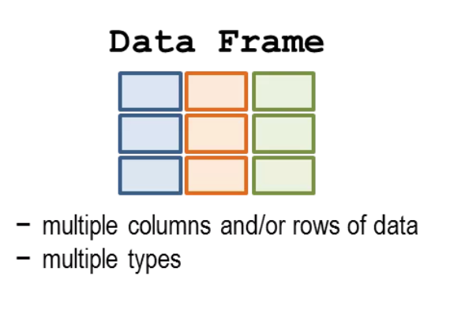
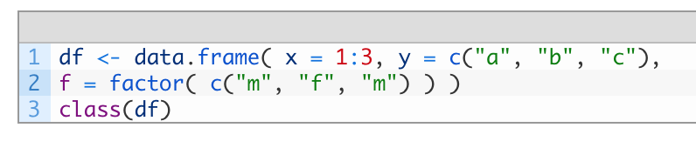
Data frame
A data frame is used for storing data tables.
It is less strict than a matrix, allowing different data types to be incorporated.
It is a collection of vectors and/or factors all having the same length
A data frame generally has column names and row names attributes
You instantiate a data.frame with function data.frame()
Although more often we auto-create data.frame by reading some data from a file using the read.table() function
names
x
y
f
1
a
m
x is numeric
y is character
f is factor
df =
2
b
f
3
c
m

Slide 40
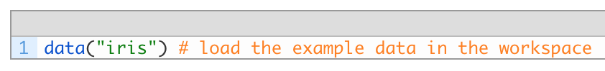
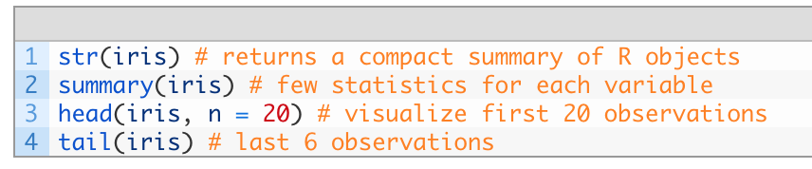
Exploring data frames
R provides some example data that can be called using the data() function
The iris’ data.frame which gives the measurements in centimeters of the variables sepal length and width and petal length and width, respectively, for 50 flowers from each of 3 species of iris
To explore the data frame, the following functions are useful

Slide 41
Subsetting data frames
Like matrices, the [i,j]-index notation is valid also for data.frames
names
x
y
f
1
a
m
df =
2
b
f
3
c
m
1
df[,1] =
2
df[2,2] =
b
3

Slide 42
Subsetting data frames
Alternatively, we may also access parts of the data frame via name
names
x
y
f
1
a
m
df =
2
b
f
3
c
m
Using the $ notation
Quoting the name in the jth slot
a
m
1
m
df$y =
b
df[,”f”] =
f
df[,c(“x”,”f”)] =
2
f
c
m
3
m

Slide 43
Lists

Slide 44
List
A list is a generic vector that can contain multiple data types
Unlike a data frame, it can contain multiple data structures of different dimensions!
A list is instantiated using the list() function
n
s
b
x = list(n, s, b, 3)
2
aa
TRUE
Position 1 2 3 4
3
bb
FALSE
n
s
b
2
aa
TRUE
3
5
cc
x =
TRUE
3
bb
FALSE
dd
FALSE
5
cc
TRUE
ee
FALSE
dd
FALSE
ee
FALSE
numeric
character
logical

Slide 45
List slicing
We retrieve a list slice with the single square bracket "[]" operator. The following is a slice containing the second member of x, which is a copy of s.
Position 1 2 3 4
n
s
b
2
aa
TRUE
3
aa
3
bb
FALSE
bb
x[2] =
x[2] =
5
cc
TRUE
cc
dd
FALSE
dd
ee
FALSE
ee

Slide 46
List slicing
We may access multiple elements of a list by specifying a vector of position indices
Position 1 2 3 4
n
s
b
2
aa
TRUE
3
aa
3
3
bb
FALSE
bb
x[c(2,4)] =
x[c(2,4)] =
5
cc
cc
TRUE
dd
FALSE
dd
ee
FALSE
ee

Slide 47
List member reference
List entities can be access via double brackets [[]]. This is a member reference, and allows us to access a part of the list instead of subsetting it as a separate entity
Position 1 2 3 4
n
s
b
2
aa
TRUE
3
3
bb
FALSE
x[[2]] =
5
cc
TRUE
dd
FALSE
ee
FALSE

Slide 48
List member reference
The use of [[]] allows us to change values inside x
Position 1 2 3 4
Position 1 2 3 4
n
s
b
n
s
b
2
aa
TRUE
3
2
ta
TRUE
3
3
bb
FALSE
3
bb
FALSE
x[[2]] =
x[[2]][1] = "ta” =
5
cc
TRUE
5
cc
TRUE
dd
FALSE
dd
FALSE
ee
FALSE
ee
FALSE
We access list element 2, at its first position. And changed its value

Slide 49
List member names
We can assign names to list members, and reference them by names instead of numeric indexes.
v = list(bob=c(2, 3, 5), john=c("aa", "bb"))
Position 1 2
2
aa
2
bob
john
v["bob"] =
v[c("john", "bob")] =
3
bb
3
2
aa
5
5
v =
3
bb
5
2
2
aa
3
v$bob =
v[["bob"]] =
3
bb
5
5

Slide 50
Importing data into R

Slide 51
Importing Data (Excel)
Quite frequently, the sample data is in Excel format, and needs to be imported into R prior to use. For this, we can use the function read.xls from the gdata package. It reads from an Excel spreadsheet and returns a data frame. The following shows how to load an Excel spreadsheet named "mydata.xls". This method requires Perl runtime to be present in the system.
> library(gdata) # load gdata package
> help(read.xls) # documentation
> mydata = read.xls("mydata.xls") # read from first sheet

Slide 52
Importing Data
The read.table() function is one of the most common ways of loading data into R workspace
Save the following in a text file separated by space as “mydata.txt” with a text editor
100 a1 b1
200 a2 b2
300 a3 b3
400 a4 b4
In the R console or as a script, load the data into a data frame called mydata
mydata = read.table("mydata.txt") # read text file
mydata #see contents
To find out more about the read.table function and its arguments, type help(read.table)

Slide 53
Importing Data
Another way is to store the data as comma separated values (CSV) format in which case, we may use the read.csv() function
Col1,Col2,Col3
100,a1,b1
200,a2,b2
300,a3,b3
Copy and paste the data above in a file named "mydata.csv" with a text editor, we can read the data with the function read.csv.
mydata = read.csv("mydata.csv") # read csv file
mydata
The first row of the data file should contain the column names instead of the actual data. Here is a sample of the expected format.

Slide 54
Working directory
Finally, the code samples above assume the data files are located in the R working directory, which can be found with the function getwd.
You can select a different working directory with the function setwd(), and thus avoid entering the full path of the data files.
Note that the forward slash should be used as the path separator even on Windows platform.
getwd() # get current working directory
setwd("<new path>") # set working directory
setwd("C:/MyDoc")

Slide 55
Special programmatic elements

Slide 56
Special programmatic elements
%in%
Special values
Apply

Slide 57
%in%
%in% operator in R, is used to identify if an element belongs to a vector.
<is something> %in% <this?>
v1 <- 3
v2 <- 101
t <- c(1,2,3,4,5,6,7,8)
v1 %in% t
v2 %in% t

Slide 58
%in%
In the case of is v1 is present in t, the output will be
TRUE
In the case of is v2 is present in t, the output will be
FALSE

Slide 59
%in%
%in% is incredibly useful in research
Suppose we want to know if our list of favorite genes g is found amongst the differential set in experiment E
E <- c("p53", "MTOR", "p63", "p73")
g <- c("p53", "p83")
g %in% E

Slide 60
%in%
g %in% E returns as “TRUE FALSE”
This tells us that p53 is found in E but not p83

Slide 61
Special values
NA (Missing data)
NaN (Not a Number)
Inf (Infinite)

Slide 62
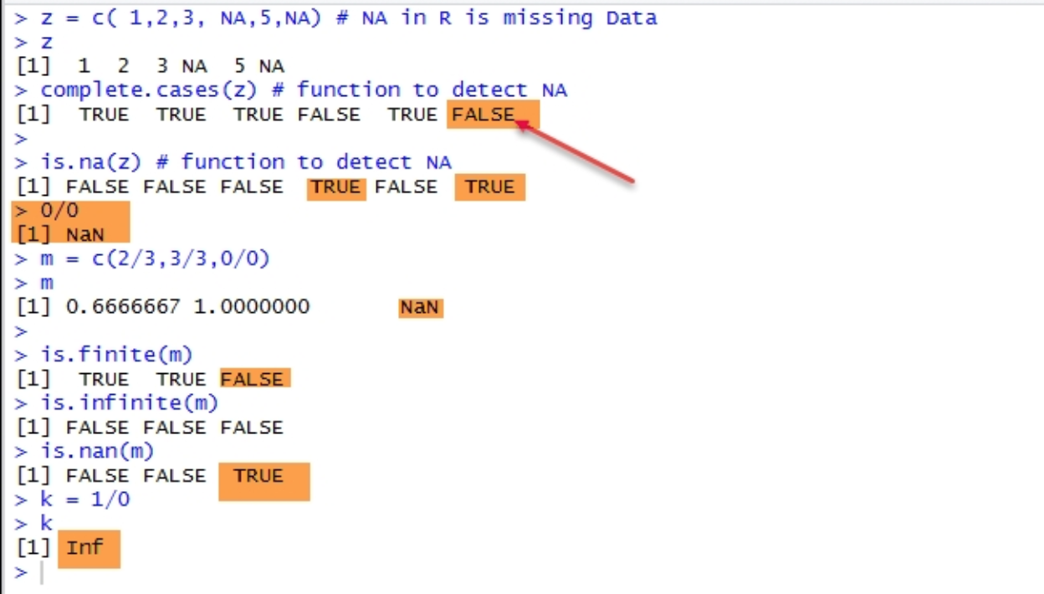
Special values

Slide 63
NA
The missing values are represented in R by NA. When we download data, it may have missing data and this is represented in R by NA
z = c( 1,2,3, NA,5,NA) # NA in R is missing Data

Slide 64
NA
To detect missing values, we can use the complete.cases() function or is.na()
complete.cases(z) # function to detect NA
is.na(z) # function to detect NA

Slide 65
NA
To remove the NA values from our data, we can do the following:
clean <- complete.cases(z)
z[clean] # used to remove NA from data
Please note the use of square brackets ([ ]) instead of parentheses.

Slide 66
NaN
In R, not a number is abbreviated as NaN. The following lines will generate NaN values
##NaN
0/0
m <- c(2/3,3/3,0/0)
m

Slide 67
NaN
The is.finite(), is.infinite(), or is.nan functions will generate logical values (TRUE or FALSE).
is.finite(m)
is.infinite(m)
is.nan(m)

Slide 68
Inf
The following line will generate inf as a special value in R
## infinite
k = 1/0

Slide 69
Apply
Loops are generally inefficient in R
Use apply() instead
apply() returns a vector or array or list of values obtained by applying a function to margins of an array or matrix.
apply(x,1,sum)
Where the first Argument X is a data frame or matrix
Second argument 1 indicated Processing along rows .if it is 2 then it indicated processing along the columns
Third Argument is some aggregate function like sum, mean etc or some other user defined functions.

Slide 70
Apply
#Create data frame
Age<-c(56,34,67,33,25,28)
Weight<-c(78,67,56,44,56,89)
Height<-c(165, 171,167,167,166,181)
BMI_df<-data.frame(Age,Weight,Height)
BMI_df

Slide 71
Apply
We want to sum the rows of this data frame

Slide 72
Apply
# row wise sum up of dataframe using apply function in R
apply(BMI_df,1,sum)
299 272 290 244 247 298

Slide 73
Apply
We want to sum the columns of this data frame

Slide 74
Apply
# column wise sum up of dataframe using apply function in R
apply(BMI_df,2,sum)
243 390 1017

Slide 75
Apply
# column wise mean of dataframe using apply function in R
apply(BMI_df,2,mean)
40.5 65.0 169.5

Slide 76
End of Segment
Let’s take a break

